Slide 1
Is it a Business Tweet?
Magnimind Academy ML Project Bootcamp
Ashutosh A. Patwardhan

Slide 2
Project Description
A rule-based algorithm (RBA) categories tweets as “Business,” “Science,” “Art,” “News,” etc;
A human editor then classifies each tweet as having been correctly or incorrectly categorized by the RBA;
The project’s goal is to develop a machine-learning model that mimics the human editor for tweets categorized as “Business;”
Given that the RBA has categorized a tweet as “Business,” build a machine learning model that produces the same Correct/Incorrect classification as a human editor
While minimizing False Positives (Positive = Correct categorization) – in other words, we don’t want to tell a user that it is a “Business” tweet and it turn out to not be a “Business” tweet.

Slide 3


Metric
 | Categorized incorrectly | Categorized correctly
Actual incorrect (Class 0) | TN | FP
Actual correct (Class 1) | FN | TP
$$FPR=1−TNR$$
Minimize FPR => Maximize TNR
$$TNR=\frac{TN}{TN+FP}$$
TNR also called specificity or selectivity
Specificity of Class 1 is obtained by calculating the recall of Class 0.

Slide 4
Data Exploration and Pruning
785,916 tweets in total;
164,602 tweets categorized as “Business;”
30,024 tweets classified as Correct/Incorrect in “Business” category;
Remaining “Business” tweets either not yet classified, or inconclusive or duplicates;

Slide 5
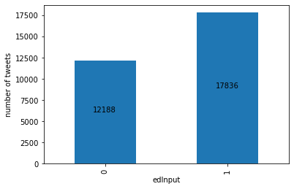
Check for Imbalance
Out of 30,024 tweets categorized as “Business”:
12,188 (41%) were classified incorrectly;
17,836 (59%) were classified correctly;
Not so good for RBA;
Reasonably balanced data set for our purpose;
Address by:
class_weight=‘balanced’
resampling

Slide 6
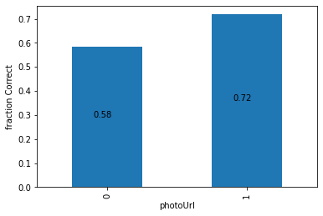
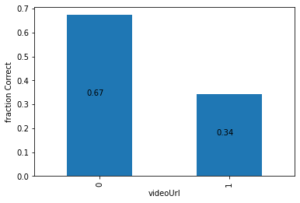
Photos and Videos
Do photos and videos impact categorization?
8% of rows have a photo;
24% of rows have a video;
The photo and video itself will not be analyzed/used as a feature in this project, but just the presence or absence may of a photo/video may be associated with its classification as Correct/Incorrect;
Introduced a 0 /1 to indicate the absence of a photo; similarly for video. These are possible features.

Slide 7
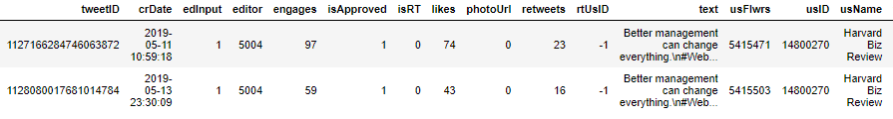
Duplicate Tweets
30,024 rows;
30,021 unique entries in the text column;
There are three duplicate tweets;
These should have been marked as edInput=4, but appear to have been missed;
Options:
Outright delete one from each duplicate pair of tweets;
Combine information like retweets, likes, etc.
Since these are 3 out of 30,024 rows, I left it as is.

Slide 8
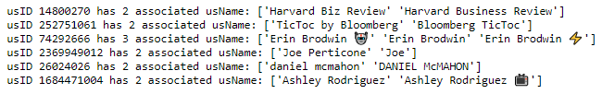
Consistency between usID and usName
449 unique usName;
443 unique usID;
Perhaps some users write tweets that are easy to categorize as “Business”.
Changed to one uniform usName.
E.g., “Harvard Business Review”
Hesitated to changed to one uniform usID.
Only one tweet. Left unchanged.

Slide 9
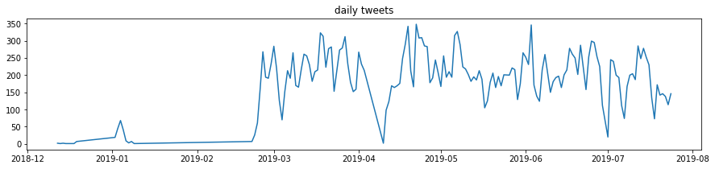
Daily Tweet Rate
“Business” category introduced on a trial basis in January 2019?
Permanent basis at the end of February?
Some data issue at the end of April?

Slide 10
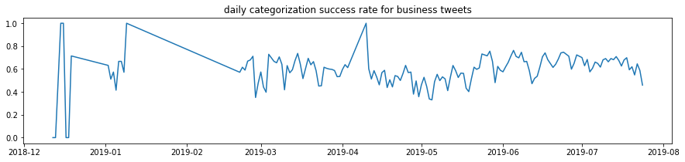
Daily Success Rate - Stationarity
No significant trend over time.
World did not change.
Stationary, assuming RBA was not tweaked.

Slide 11
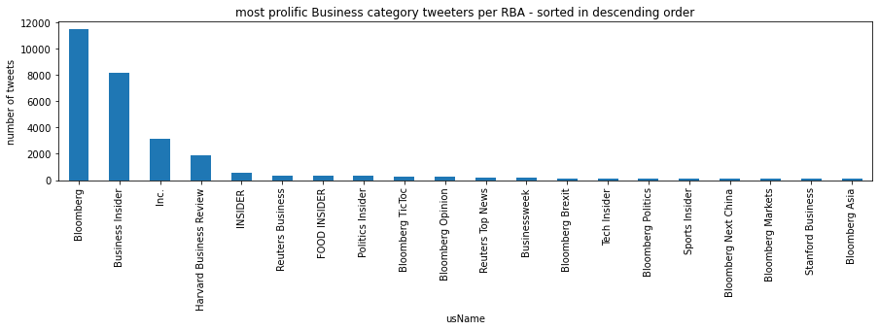
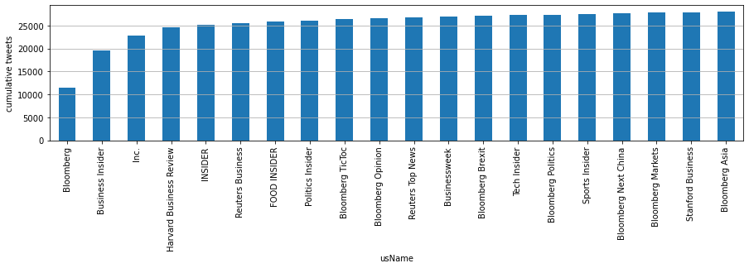
Prolific Tweeters
25,000 out of 30,000 tweets were by 5 out of 443 tweeters.
These five tweeters will heavily influence the ML model.
Bloomberg: > 33%
Business Insider: ~25%
Lots of Bloombergs! Could be consolidated (not done).

Slide 12
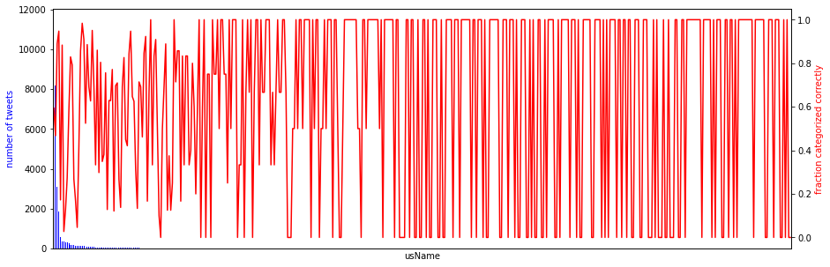
Are some Tweeters Easier to Characterize?
Success rate was 0% or 100% for those with just one tweet.
Not surprising.
What about these?

Slide 13
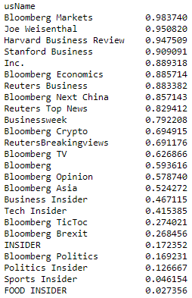
Are some Tweeters Easier to Characterize?
Success rate appears to be higher for business-oriented tweeters – some business-related word in usName;
Also exceptions like Joe Wiesenthal;
Could create a feature related to business-related word in usName. Not done.
25 most-prolific tweeters sorted by success rate.

Slide 14
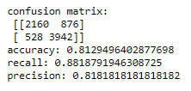
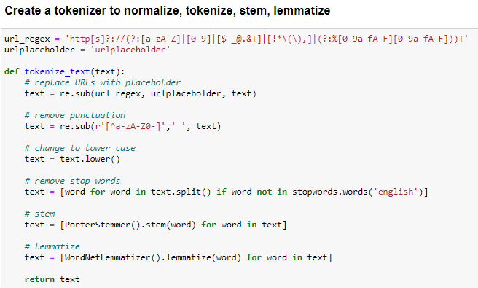
Baseline Classifier
Tweet text only
876 false positives;
We want to minimize this number during hyperparameter tuning.
train_test_split()
CountVectorizer(tokenizer=tokenize_text)
TfidfTransformer()
BernoulliNB()

Slide 15
Improve on Baseline Classifier
Reduce dimensionality;
Try other than naïve Bayes (BernoulliNB) classifier;
Include features in addition to tokenized tweets;
Tune hyperparameters.

Slide 16
Dimensionality Reduction
Tokenization of the tweets produced 16,469 features (words);
Two methods of dimensionality reduction were tried:
TurncatedSVD (like PCA, but using sparse input);
CountVectorizer with minimum document frequency specified.

Slide 17
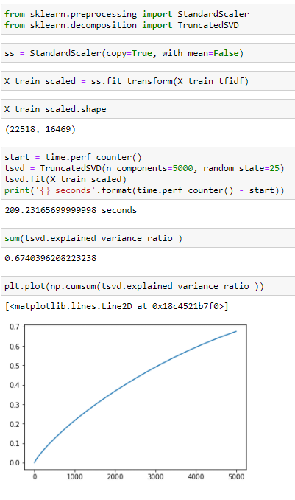
TruncatedSVD
Original number of features: 16,469;
Used 5,000 components;
Only 67% of feature variance was captured;
Approximately 10,000 features will be needed to capture 90% of feature variance.

Slide 18
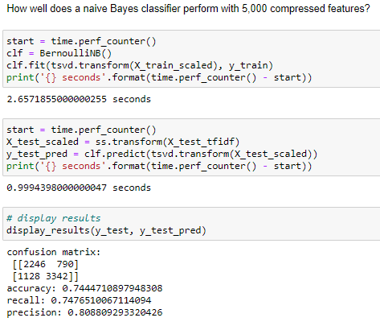
TruncatedSVD
With 5,000 components capturing 67% of feature variance:
Accuracy: 0.81 → 0.74
Recall: 0.88 → 0.75
Precision: 0.82 → 0.81
FP: 528 → 1128
Need to use many more components;
Not promising.

Slide 19
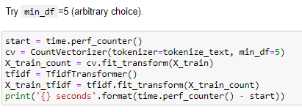
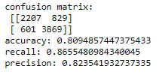
Minimum document frequency
Specify minimum document frequency of 5 (arbitrary choice);
Accuracy: 0.81 → 0.81
Recall: 0.88 → 0.87
Precision: 0.82 → 0.82
FP: 528 → 601
Same as baseline classifier;
Use this method to reduce dimensionality.

Slide 20
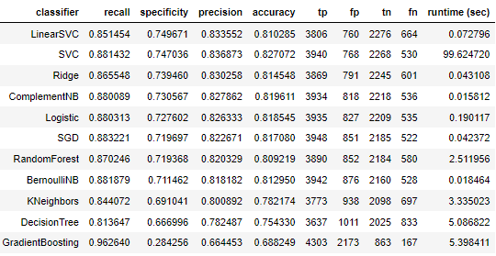
Try other classifiers (default parameters)
Several classifiers produce better selectivity than BernoulliNB, the baseline classifier;
SVC take considerably longer to fit and transform than others;
LinearSVC has the best sensitivity, while accuracy and runtime are also good;
I will use LinearSVC for further development.

Slide 21
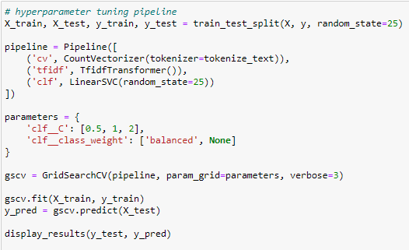
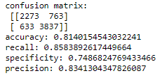
LinearSVC Hyperparameters Tuning
Optimal parameters:
C = 0.5, class_weight=None
No improvement in specificity – not surprising…
Issues:
Takes a long time because CountVectorizer() is run each time;
Use scoring function for Class 1 during GridSearchCV()
GridSearchCV crashes on Windows if n_jobs is not 1.

Slide 22
Remaining Work
Include presence/absence of photos and videos in feature set;
Minimum document frequency in CountVectorizer();
Tune hyperparameters using specificity as the scoring function.

